Slide 1
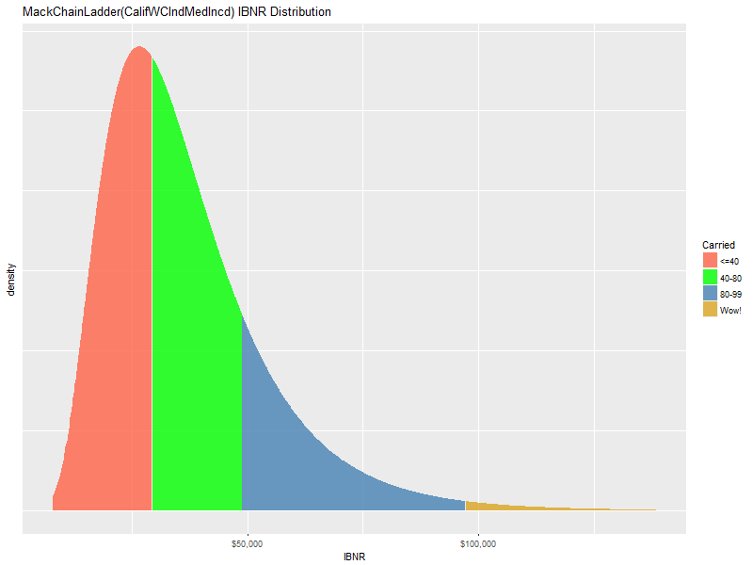
Mack/Murphy Unchained
CLRS 2018 Anaheim CA Daniel Murphy Trinostics

Slide 2

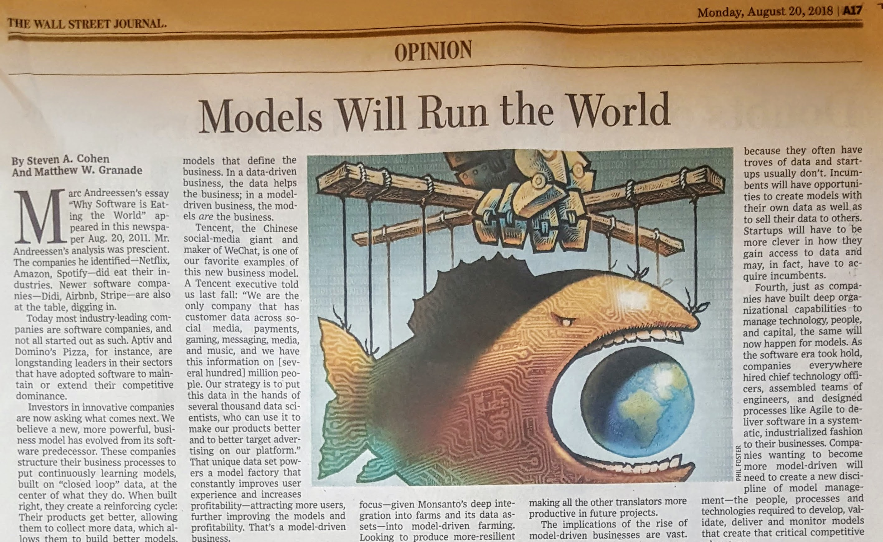
Strats
In a model-driven business, the models are the business
Notes:
Steven Cohen, Matthew Granade, Point72 LP

Slide 3
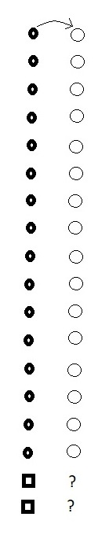
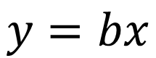
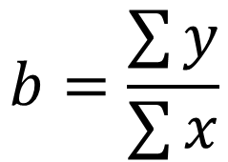
Chain-Ladder First Link: The Method
method
$$y=bx$$
We observe some objects that have changed over time (the circles)
We observe two new objects (the squares)
What is an estimate of their changed values?
traditional average link ratio
$$b=\frac{\sum{y}}{\sum{x}}$$

Slide 4
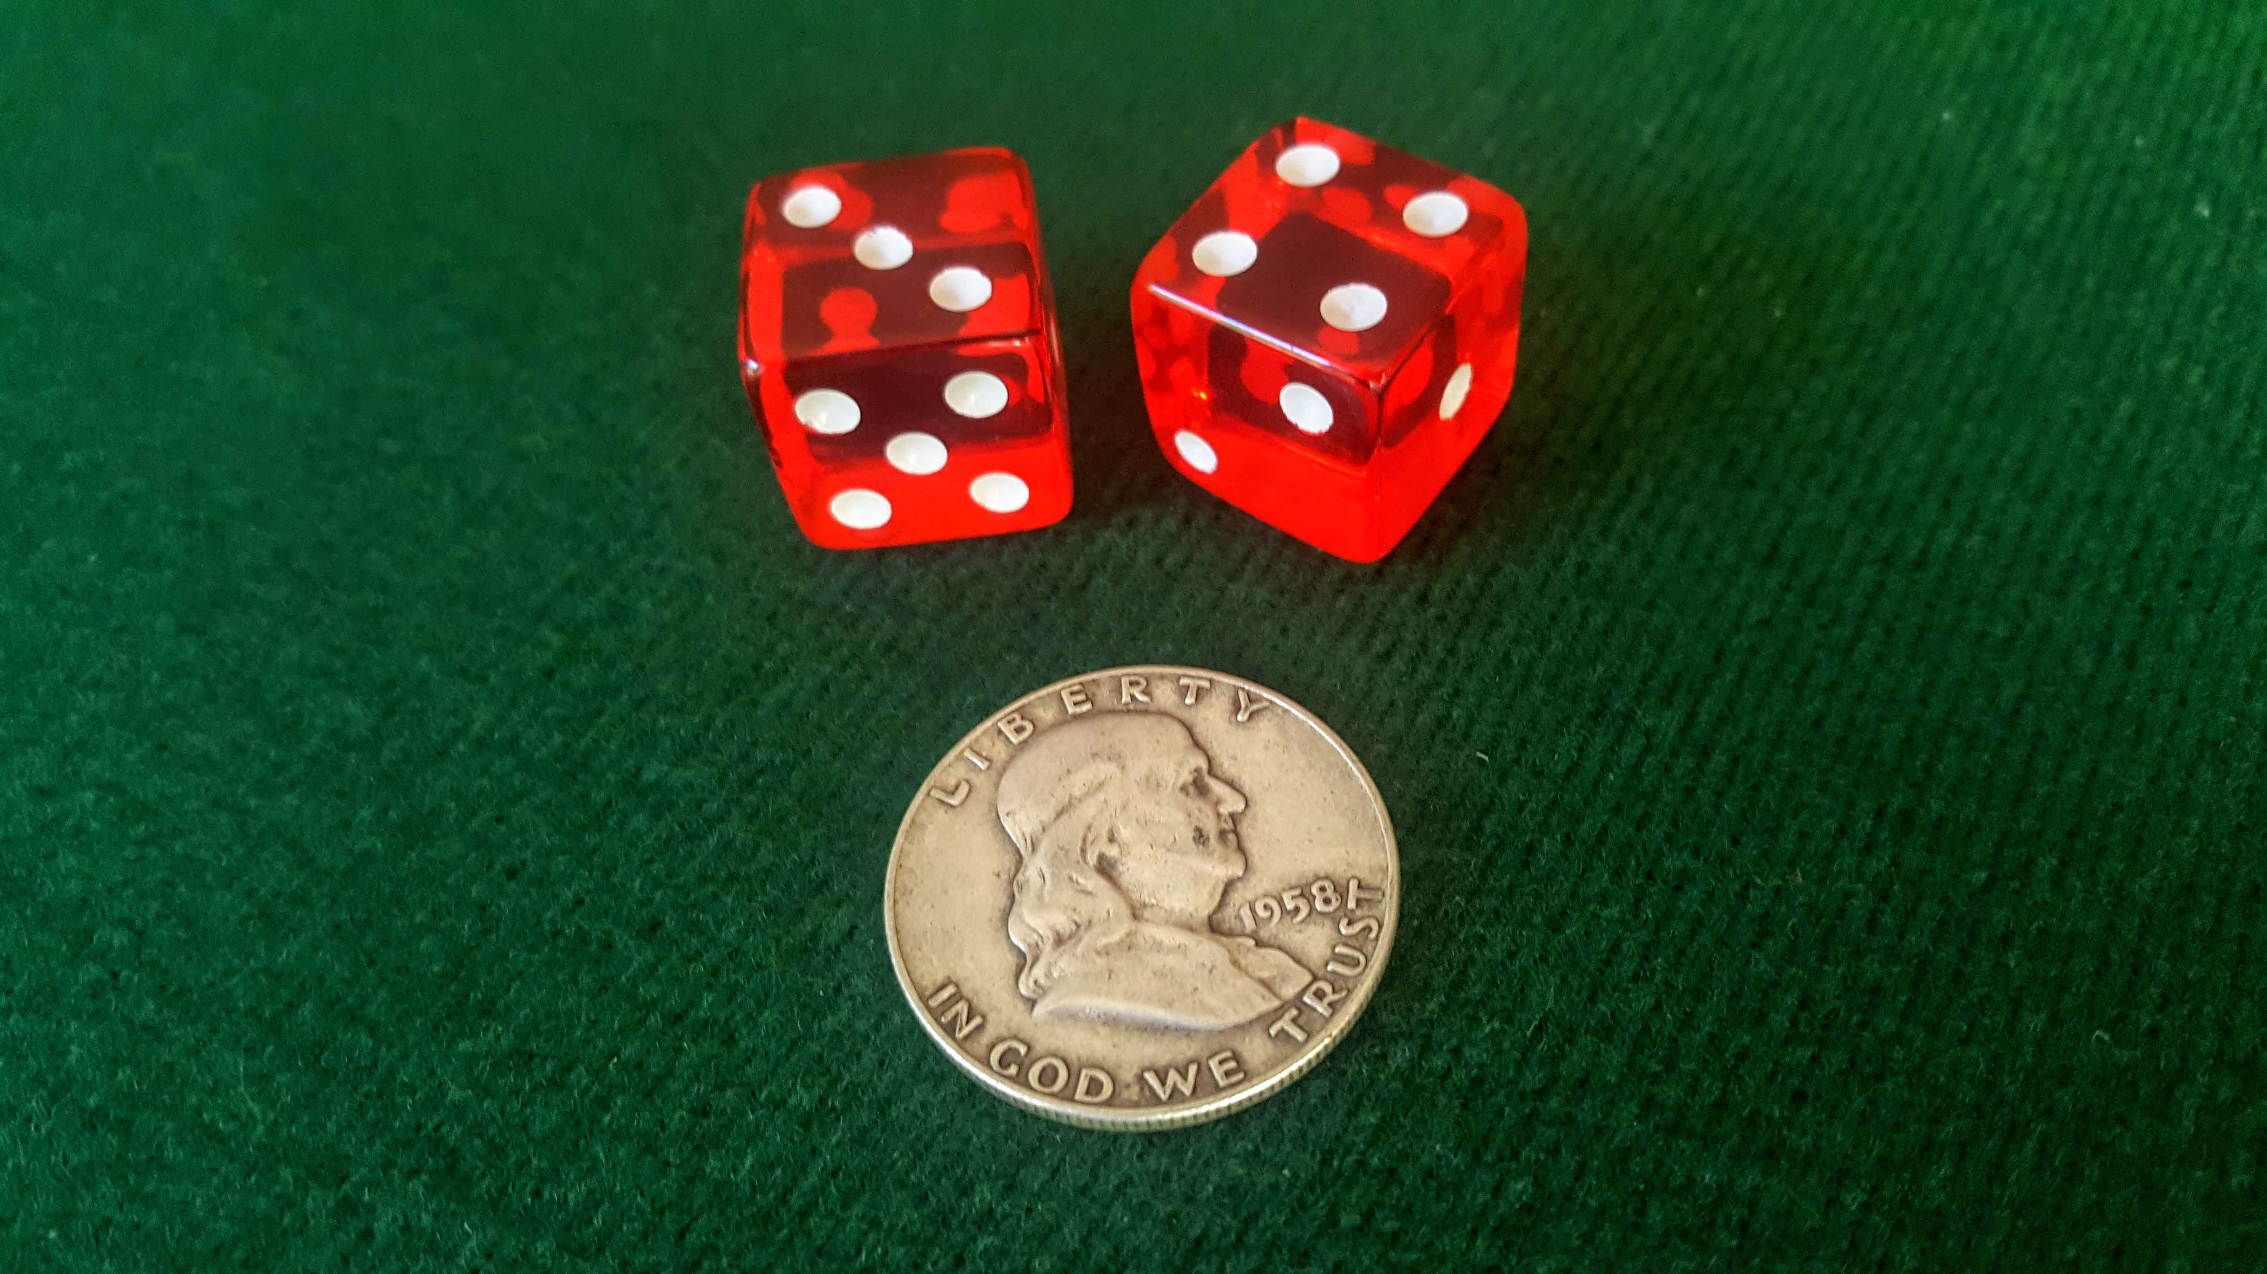
Let’s play a game
* biased coin idea thanks to https://izbicki.me/blog/how-to-create-an-unfair-coin-and-prove-it-with-math.html
Notes:
E(1D)=3/5
V(1D)=1/6*(2.5^2+1.5^2+.5^2)*2=70/24=2.91
E(2D)=2*E(1D)
V(2D)=2*V(1D)

Slide 5

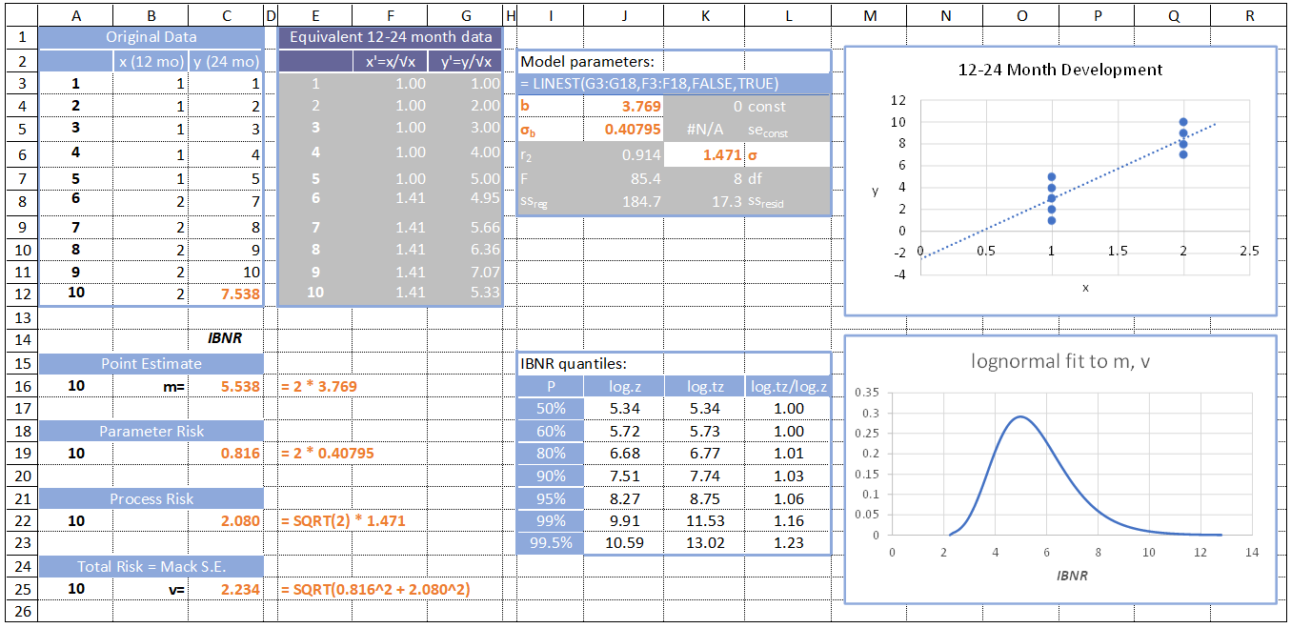
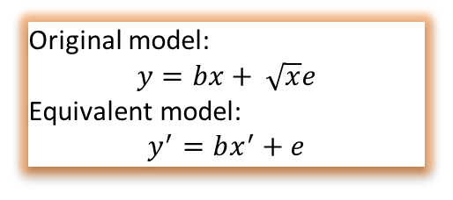
Predictions are not certain: prediction bands
Original model:
$$y=bx+ \sqrt{x}e$$
Equivalent model:
$$y^{′}=bx^{′}+e$$
Three stats from equivalent model’s data are applied to original model’s data
With
* m, v notation c/o Wikipedia (lognormal)

Slide 6
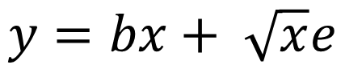
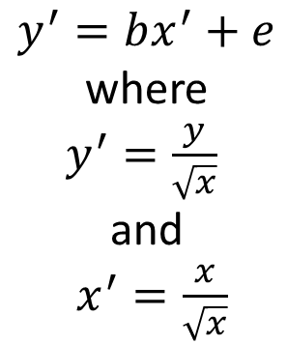
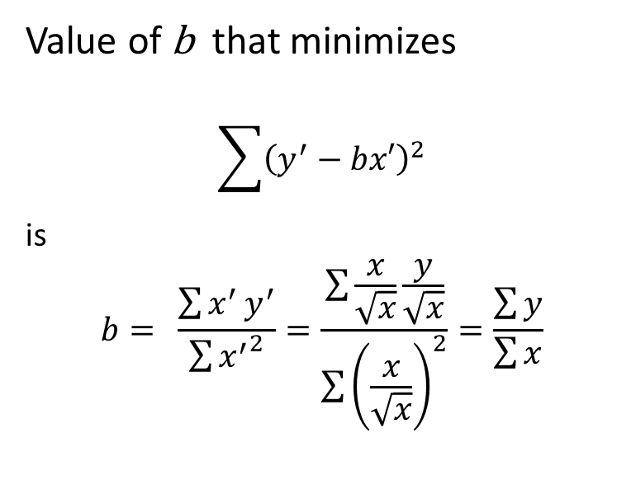
Chain-Ladder First Link: The Model
error term makes it a model
$$y=bx+ \sqrt{x}e$$
equivalent model
Value of b that minimizes
$$\sum{{\left(y^{′}−bx′\right)}^{2}}$$
is $$b= \frac{\sum{x^{′}}y^{′}}{\sum{{x^{′}}^{2}}}=\frac{\sum{\frac{x}{\sqrt{x}}\frac{y}{\sqrt{x}}}}{\sum{{\left(\frac{x}{\sqrt{x}}\right)}^{2}}}=\frac{\sum{y}}{\sum{x}}$$
Calculus
$$y^{′}=bx^{′}+e$$
where
$y^{′}=\frac{y}{\sqrt{x}}$
and
$x^{′}=\frac{x}{\sqrt{x}}$

Slide 7
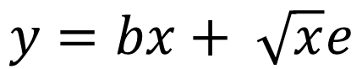
Chain-Ladder First Link: An Example
Apply the model to this skinny triangle
$$y=bx+ \sqrt{x}e$$

Slide 8
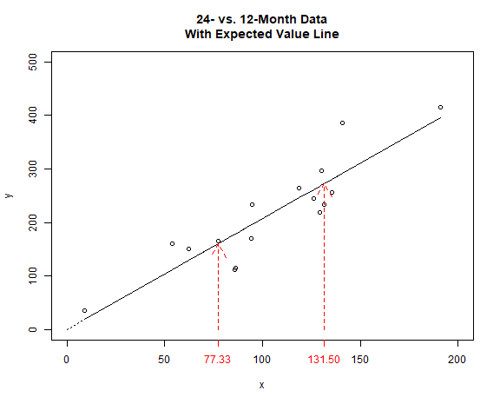
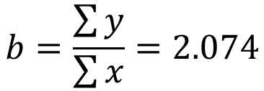
12-24 Month Development Experience
$$b=\frac{\sum{y}}{\sum{x}}=2.074$$
2.074 = slope of the line through origin
prediction of new initial observations: 77.33 -> 160.4 131.5 -> 272.7

Slide 9
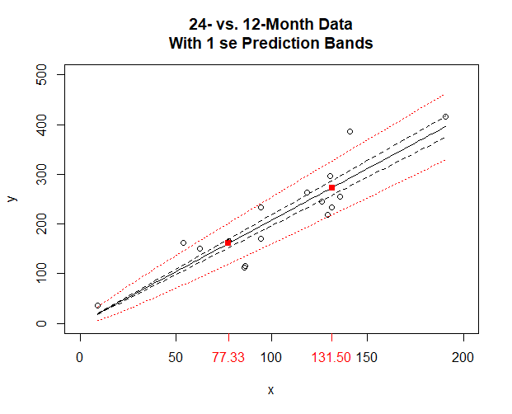
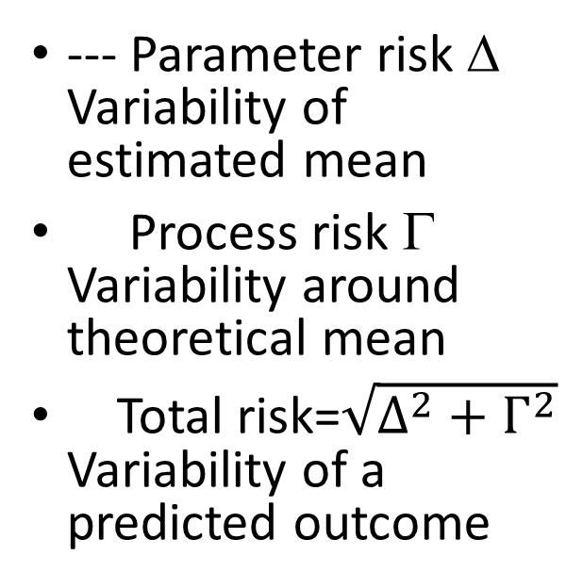
Predictions are not certain: prediction bands
--- Parameter risk Δ Variability of estimated mean
Process risk Γ Variability around theoretical mean
Total risk=$\sqrt{Δ^{2}+Γ^{2}}$ Variability of a predicted outcome
* notation by Ali Majidi
Notes:
Notation by Ali Majidi

Slide 10

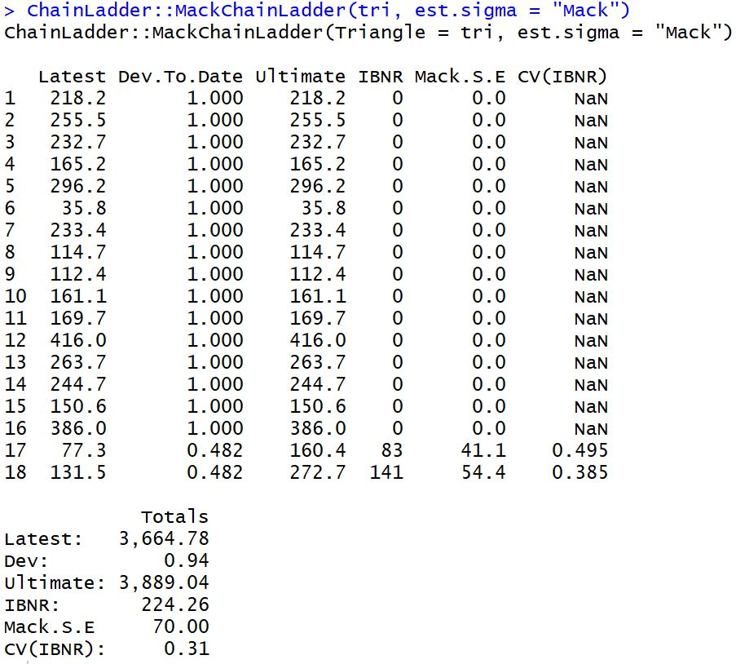

Predictions are not certain: prediction bands
With
} 54.4
} 41.1
* ChainLadder package by Markus Gesmann et.al.

Slide 11
Why does the prediction envelope fan out only at the high end?

Slide 12
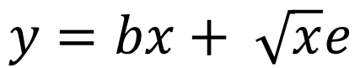
Chain-Ladder link
hint
$$y=bx+ \sqrt{x}e$$
Assumption is, The higher the initial value, the greater the variability of the subsequent value
When might you have less variability the larger the beginning value?

Slide 13
How do prediction bands look under different models?

Slide 14
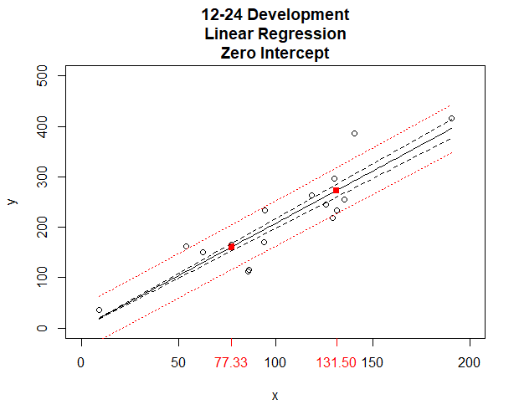
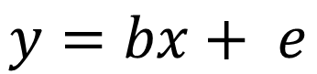
Prediction bands without square-root-o-skedasticity
$$y=bx+ e$$
--- parameter risk
total risk
Notes:
image Dev12-24LinRegZeroIntercept.png
script WithIntercept MoreDisperse.R

Slide 15
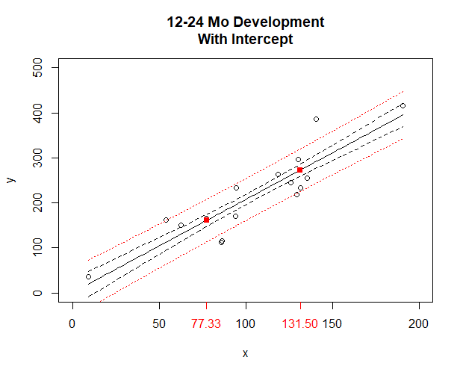
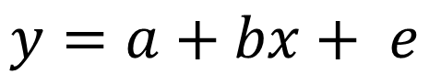
Prediction bands when there’s an intercept
$$y=a+bx+ e$$
--- parameter risk
total risk

Slide 16
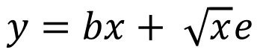
Homework
What would the graph of the model look like if the simple average is the optimal link ratio?
Does the answer change if “optimal” is a matter of actuarial judgment?
What could be drivers of a non-zero intercept?
How to model the BF method within the Chain-Ladder paradigm?
How to model the first column within the Chain-Ladder paradigm?
Prove that our game satisfies the assumptions of the model
$$y=bx+ \sqrt{x}e$$

Slide 17
Bornhuetter-Ferguson
What is the slope of the line?
What is the intercept?

Slide 18
Chain-Ladder Second Link: Add Another Column

Slide 19
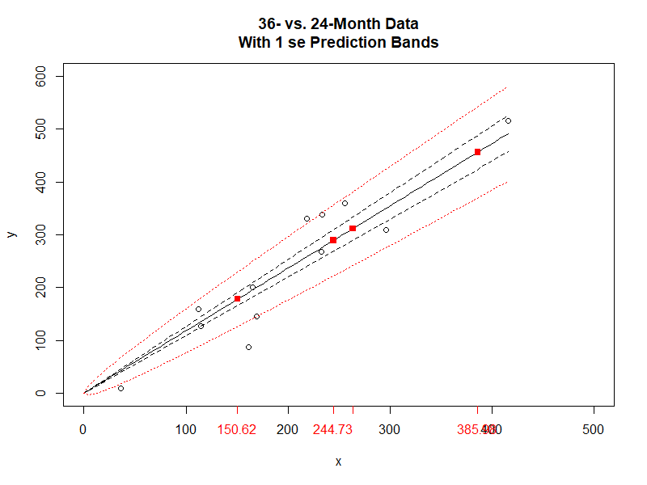
Chain-Ladder Second Link: Add Another Column
b_{y} = 1.181
sigma_b_{y} = 0.083
sigma_{y} = 4.1

Slide 20
Chain-Ladder predicts the future recursively
Orange projections are products of a scalar and an estimated parameter
Which is which?
Formulas for Parameter Risk and Process Risk can be found in slides above
Red projections are products of an estimate and an estimated parameter
Formulas for Parameter Risk and Process Risk are derived from the Law of Total Variance

Slide 21
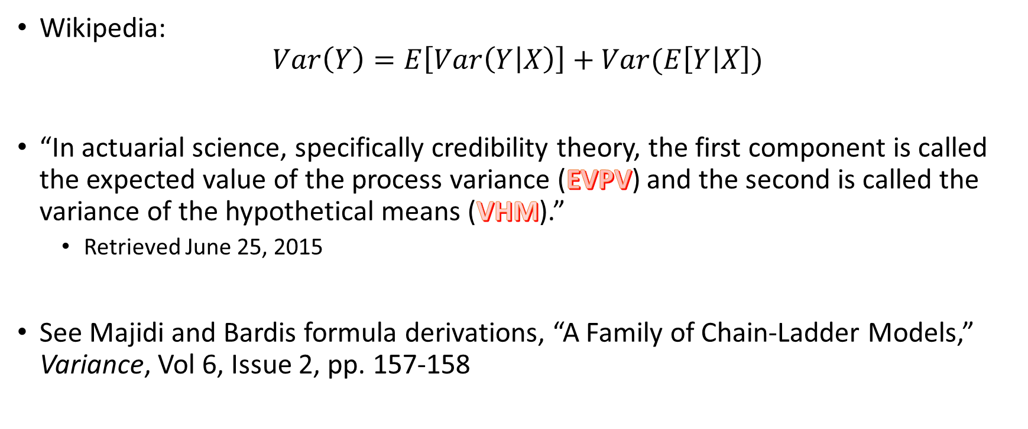
Law of Total Variance
sidebar
Wikipedia: $Var\left(Y\right)=E\left[Var\left(Y | X\right)\right]+Var(E\left[Y | X\right])$
“In actuarial science, specifically credibility theory, the first component is called the expected value of the process variance (EVPV) and the second is called the variance of the hypothetical means (VHM).”
Retrieved June 25, 2015
See Majidi and Bardis formula derivations, “A Family of Chain-Ladder Models,” Variance, Vol 6, Issue 2, pp. 157-158

Slide 22
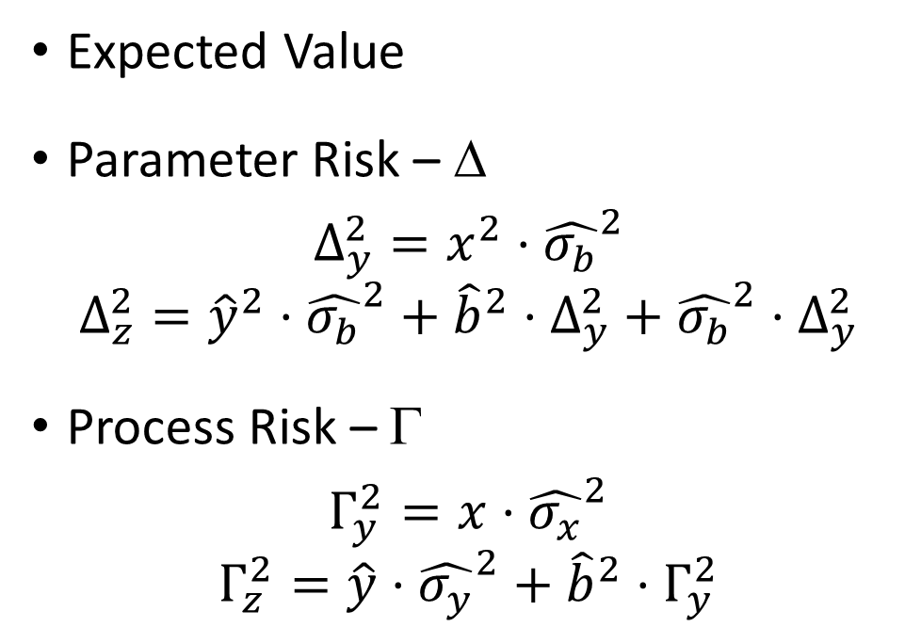
Recursive projections with statistics – complete many squares
Expected Value
Parameter Risk – Δ
$$Δ_{y}^{2}=x^{2}⋅{\hat{σ_{b}}}^{2}$$
$$Δ_{z}^{2}={\hat{y}}^{2}⋅{\hat{σ_{b}}}^{2}+{\hat{b}}^{2}⋅Δ_{y}^{2}+{\hat{σ_{b}}}^{2}⋅Δ_{y}^{2}$$
Process Risk – Γ
$$Γ_{y}^{2}=x⋅{\hat{σ_{x}}}^{2}$$
$$Γ_{z}^{2}=\hat{y}⋅{\hat{σ_{y}}}^{2}+{\hat{b}}^{2}{⋅Γ}_{y}^{2}$$
Notes:
Save all the statistics and intermediate steps

Slide 23
Tricks for Risk Estimates for the Total/sum Row

Slide 24
Why not directly estimate the 12-36 month link ratio?
What if you learned b_{xz} = sum(z) / sum(x) = 2.337
Why not say the expected 36-month value of x = 77.33 is 77.33 * 2.337 = 180.7 (se 44.7) rather than
77.33 * 2.074 * 1.181 = 189.4 (se 72.1 see above)
Notes:
se without y is 44.7
se with y is 72.1
Total IBNR
with y: 492.31, se=215.64, cv=0.44
without y: 878.14 – (263.72-118.53)-… = 280.9, se = 156.85, cv = (0.18) 156.85/280.9=.56

Slide 25
Can you ignore y or not?
There is important information in the 24-month value
The path to ultimate is important
It’s the journey

Slide 26
Continue the Journey – Chain to Ultimate
Recursive estimates are carried forward to the last pair of development columns
Technical considerations
What to do when there are not enough observations to get a good estimate of sigma (zero degrees of freedom)
What to do with a tail
Mack has recommendations for handling these technicalities
The ChainLadder package’s MackChainLadder function includes Mack’s recommendations, as well as others
Let’s see some examples

Slide 27
California WCIRB Agenda June 2018 Combined Indemnity and Medical Incurred
* triangle creation approach thanks to Dave Bellusci; data entry thanks to Connan Houser
Notes:
Thanks to Dave Bellusci

Slide 28


MackChainLadder(WCIRB Indemnity + Medical Combined Incurred, tail = 1.025)

Slide 29
Reported industry IBNR @ 3/31/2018 = $36,196
~58%-ile Very close to MackChainLadder central estimate = $36,713

Slide 30
ChainLadder sample GL triangle ‘GenIns’ (in thousands)
GenIns is a triangle first published in Taylor & Ashe paper (1983) and repeatedly studied in the literature
Notes:
Taylor, G. and F. R. Ashe. 1983. Second Moments of Estimates of Outstanding Claims. Journal of Econometrics 23, 37-61.
Loss Reserving with GLMs: A Case Study Greg Taylor and Gr~inne McGuire
Greg’s more recent paper: http://www.variancejournal.org/articlespress/articles/Empirical-Taylor.pdf

Slide 31
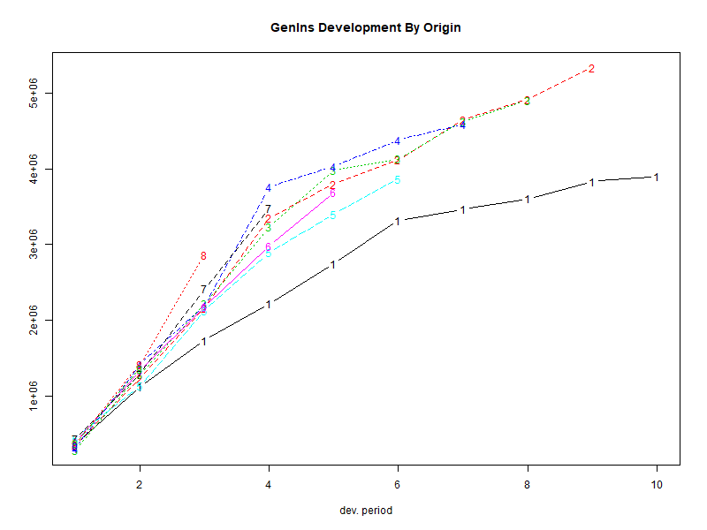
ChainLadder:: plot(GenIns)

Slide 32
MackChainLadder(GenIns)

Slide 33
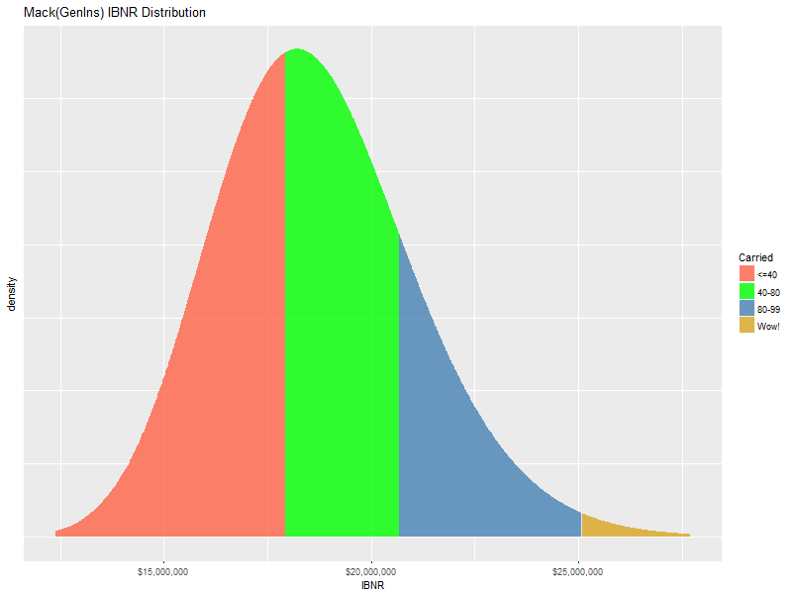
Safety Levels of GenIns Carried IBNR

Slide 34
Wrap-up: What are possible uses of an IBNR distribution?
Rather than a distribution, can Mack/Murphy be used in predictive analytics?

Slide 35
What happens when Mack/Murphy is run on detail data?
Suppose x and y are actually observations from 4 companies in 4 accident years
Will link ratios from aggregated data and detail data always be the same?
What about the risk statistics?

Slide 36
GenIns at the Claim Level
Hai You generated simulations of over 6000 synthetic claims whose accident year aggregation is “close in shape” to GenIns
We pegged the 13% cv as the primary measurement of similarity
Hai’s claim-characteristic choices included:
Frequency distribution
Severity distribution
Distribution for the number of payments per claim
Report lag and payment lag
The purpose of this exercise was to compare the Mack results on the claim detail with the statistics from the aggregate triangle

Slide 37
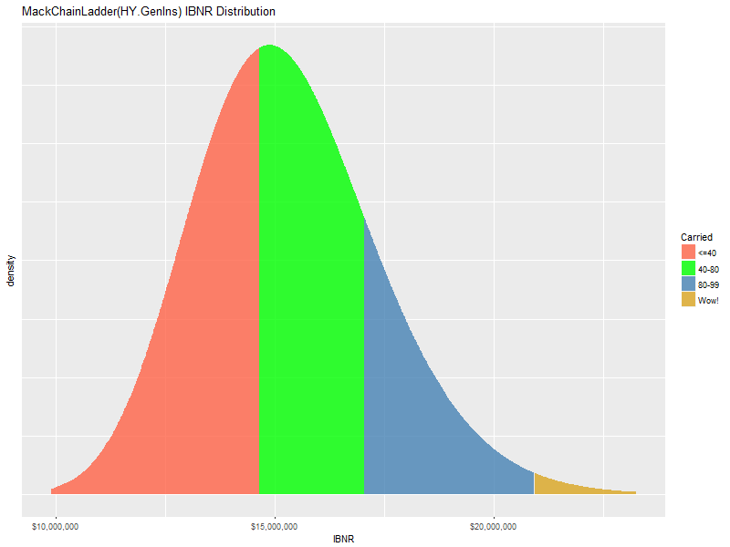
IBNR distributions from aggregated triangles are very similar
Original GenIns
Aggregated triangle from Hai data

Slide 38
GenIns at the Claim Level: Claim detail sample in triangle format
Why the IBNR drop? Why the CV drop?
* simulated claims by Hai You

Slide 39
Is the weighted average development factor appropriate?
What happened to the 12-24 factor from the claim detail?!?

Slide 40
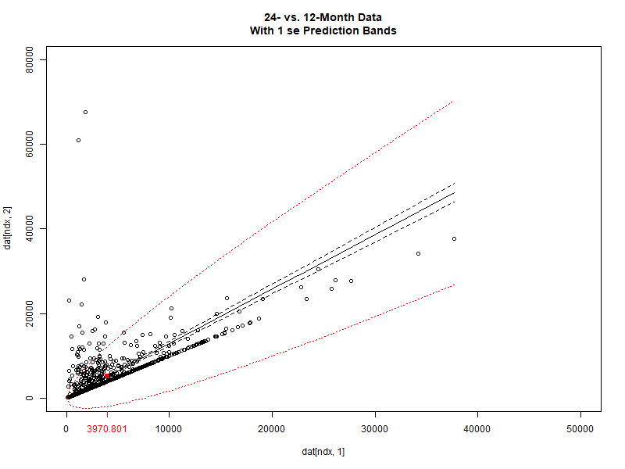
The 12-24 month relationship from the claim detail
Are Chain-Ladder assumptions violated by the detailed data?
linear regression in R:
lm(y~x)
Coefficients:
(Intercept) x
1330.6 0.96

Slide 41
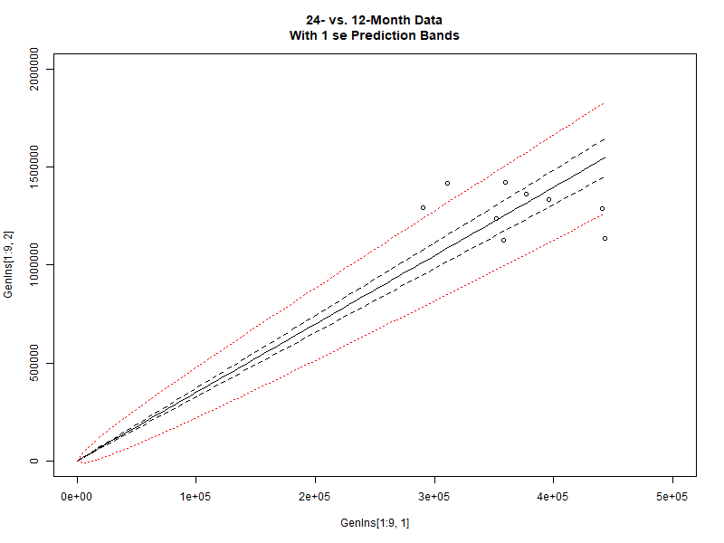
The 12-24 month relationship from the GenIns triangle
Are Chain-Ladder assumptions violated by the aggregate data?
Is that the line you would draw through that data?

Slide 42
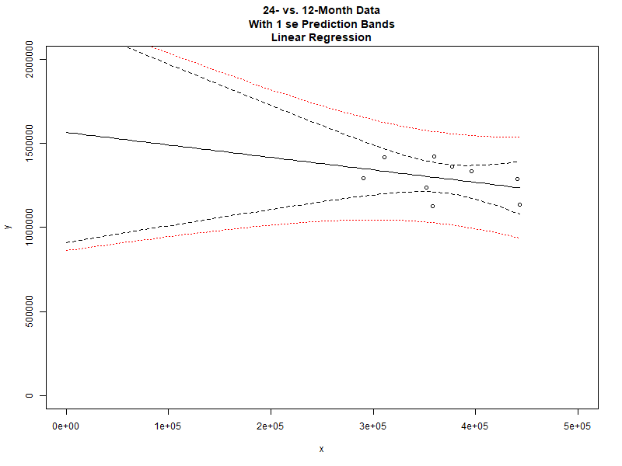
The 12-24 month relationship from the GenIns triangle
Rhetorical question: Why should this model not be considered for projecting the 12-month value?

Slide 43
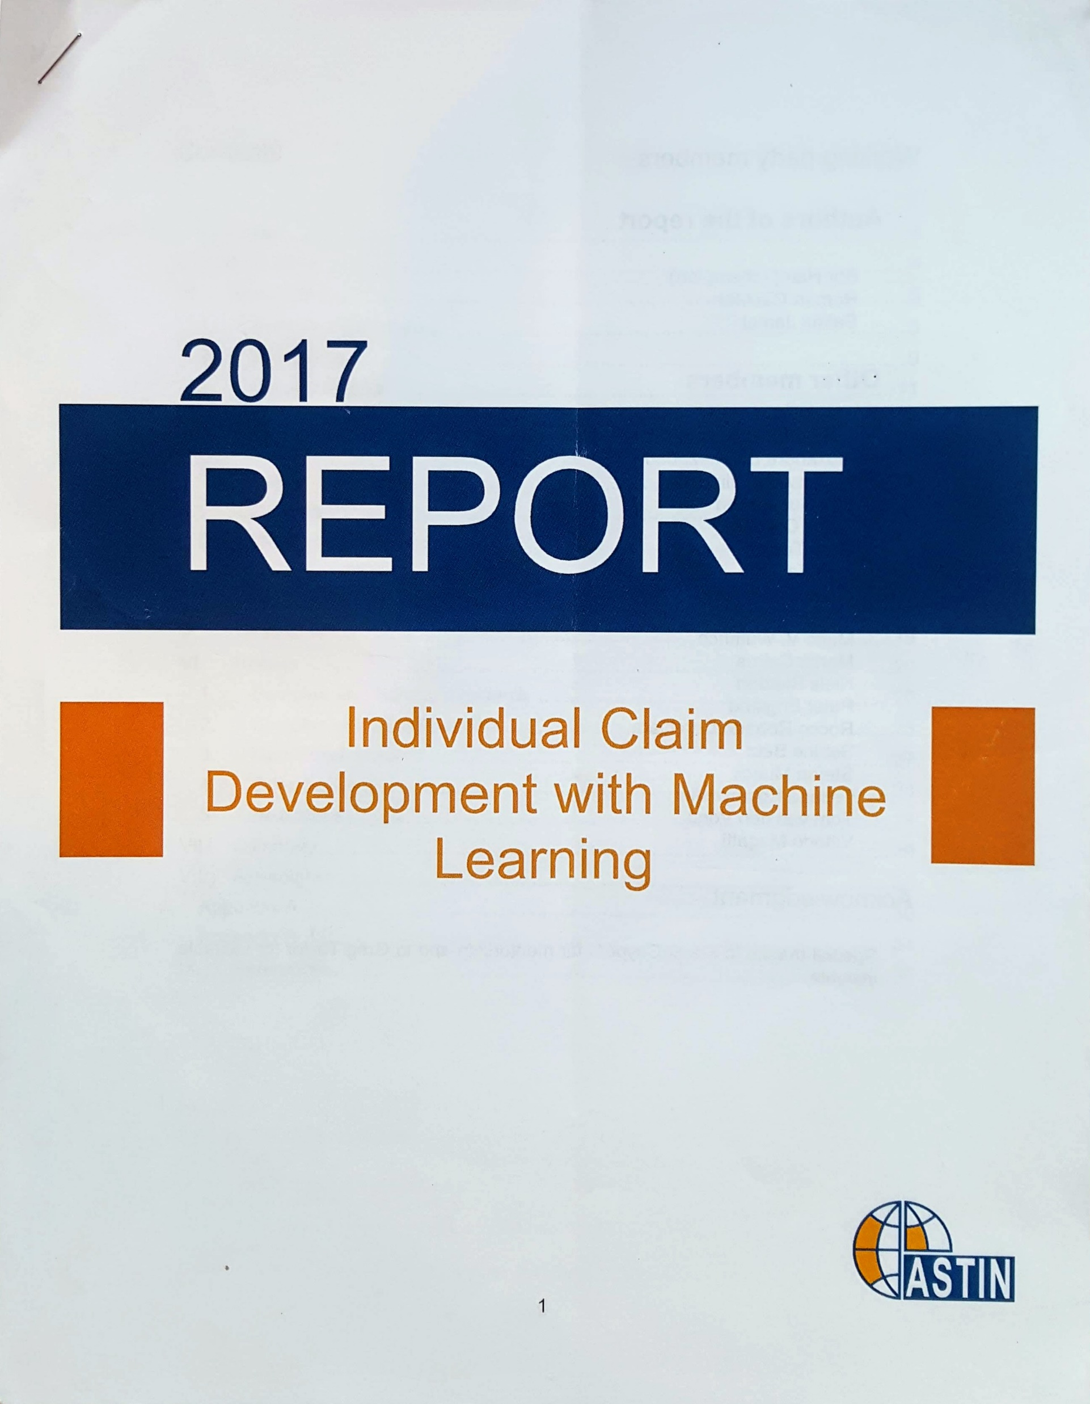
What’s next?
How to model serial correlation?
ARMA
Michael Wacek, “The Path of the Ultimate Loss Ratio Estimate”, eForum
Growth curves
Sherman; Clark; Guszcza
Bayes
Wüthrich
Individual Claim Development with Machine Learning (2017)
Neural Networks Applied to Chain-Ladder Reserving (2018)
Notes:
Rachel Boles, partial loss ratio
Guszcza, James. 2008. “Hierarchical Growth Curve Models for Loss Reserving.” In, 146–73. CAS Fall Forum; https://www.casact.org/pubs/forum/08fforum/7Guszcza.pdf

Slide 44
Can InsureTech jump the curve?
* graphics by Kirsten Singer
Notes:
Graphics by Kirsten Singer

Slide 45
Summary
Despite all its problems, the Chain-Ladder Mack/Murphy model is useful
The regression tale of development is easy to understand
Distributions help our principals make decisions
Exciting actuarial analysis in the future
Combining methods mid-stream
AI modeling of the path to ultimate
Stories/models with clarity sell best
Everybody likes pictures

Slide 46
Q&A
Thank you for coming!
Dan Murphy
dmurphy@trinostics.com

